Slide 1
Osman Mamun Richland, WA PhD in Chemical Engineering, University of South Carolina Postdoctoral fellow in Chemical Engineering, Stanford University Postdoctoral research associate, Energy & Environment Directorate, Pacific Northwest National Laboratory
Development of Deep Learning Image Caption Generator

Slide 2
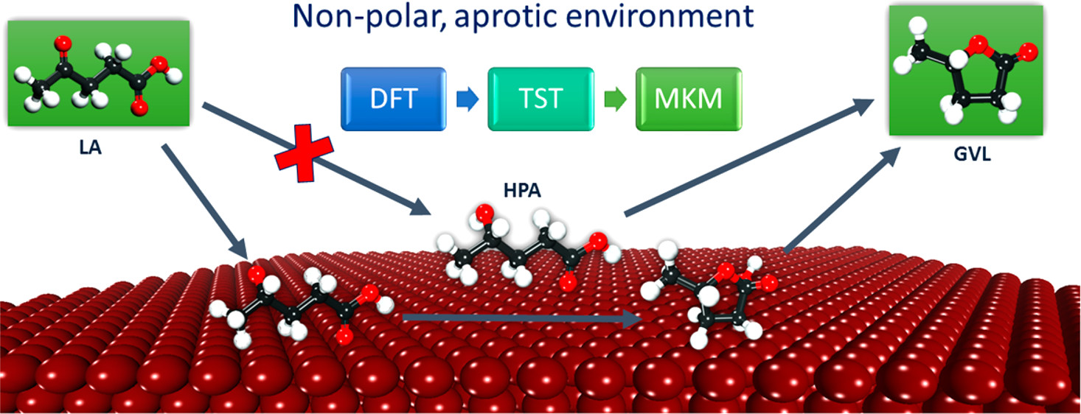
PhD in Chemical Engineering, University of South Carolina
Theoretical investigation of biomass conversion in both gas & liquid phase.
10 publications in top-tier journals, including 3 first-author papers.
Attended several conferences including AIChE, NAM, ACS etc.
Led to new research direction in biomass research.
Won 2nd prize in Southeastern Catalysis Society meeting poster presentation

Slide 3
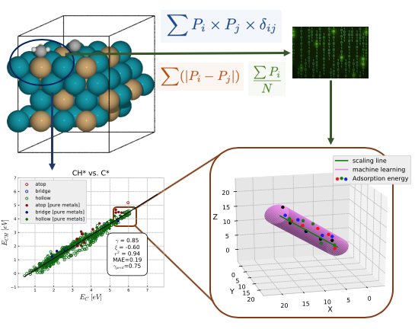
Postdoctoral Fellow in Chemical Engineering, Stanford University
High-throughput Investigation of Catalytic Properties.
5 publications in top-tier journals, including 2 first-author papers.
Attended several conferences including AIChE, NAM, ACS etc.
Built a code-base to automatically run thousands of jobs in nationwide compute servers.
Developed a Bayesian Framework to apply model selection to dense dataset based on information criteria and model averaging to sparse dataset with Boltzmann weighting when model uncertainty is higher.

Slide 4
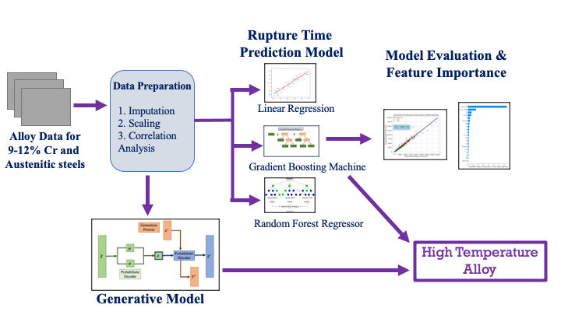
Postdoctoral Research Associate in Energy & Environment Directorate, Pacific Northwest National Laboratory
Machine Learning for high temperature novel materials discovery
3 publications in top-tier journals, including 2 first-author papers.
Attended several conferences including TMS, ICME etc.
Best paper award in EED directorate.
Integrated a predictive and generative model for exhaustive screening of materials space of interest.

Slide 5
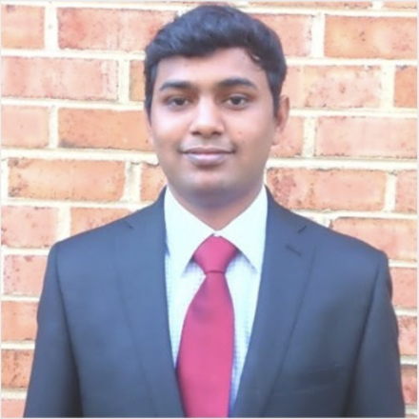
Development of Deep Learning Image Caption Generator Data Science Intensive Capstone Project, December 2020 Cohort
Acknowledgement: Prasad Seemakurthi, mentor Springboard

Slide 6
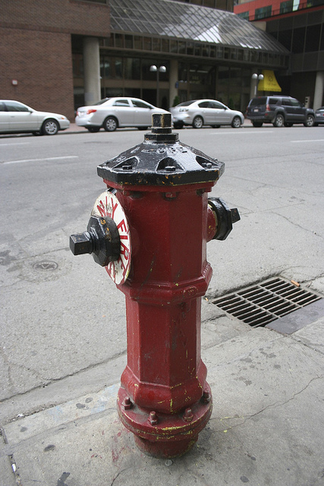
Introduction
Data Science Intensive Capstone Project
What do you see in this picture?
Some would say “a water sprinkler” or some
would say “a red water sprinkler beside a
road”.
Both of the captions are right, as it is fairly easy for human to describe such an image.
However, it is difficult for machine to describe a picture as it requires knowledge derived from the image and forming a sequence of words with coherent meaning.

Slide 7








Motivation: who might care?
Data Science Intensive Capstone Project
Travel Agencies:
Online Shopping Sites:
Image Sharing Services:
Social Media Platform:

Slide 8
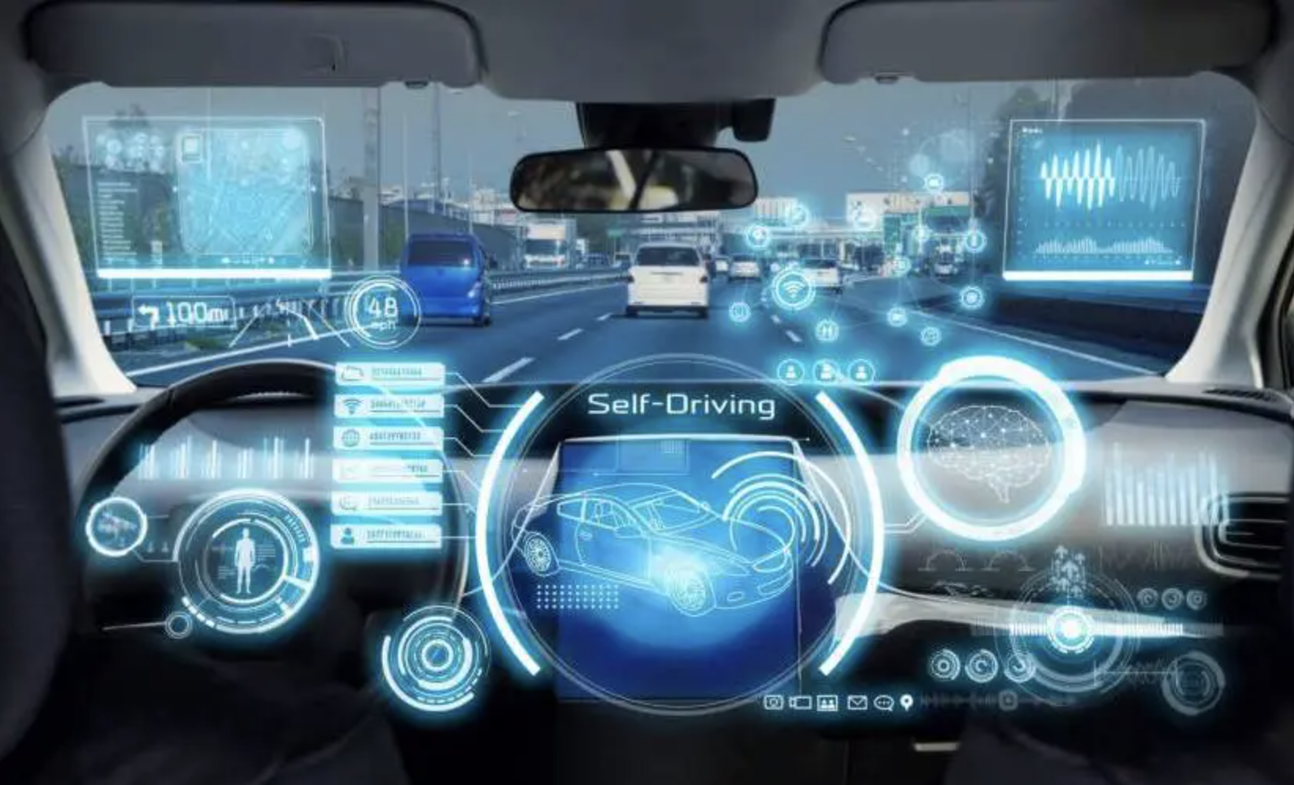
Potential Applications
Data Science Intensive Capstone Project
Blind aid: It can be used to aid blind people navigate better in the world. The image caption generator will convert the scene around into text and later the text can be converted to speech, thus greatly enhancing the life quality of individuals with vision related disabilities.
Self driving cars: By properly captioning the roadside, we can greatly boost the security of the self driving car system.
Image credit: https://readwrite.com/2020/01/21/ how-self-driving-cars-can-shape-our-future/

Slide 9
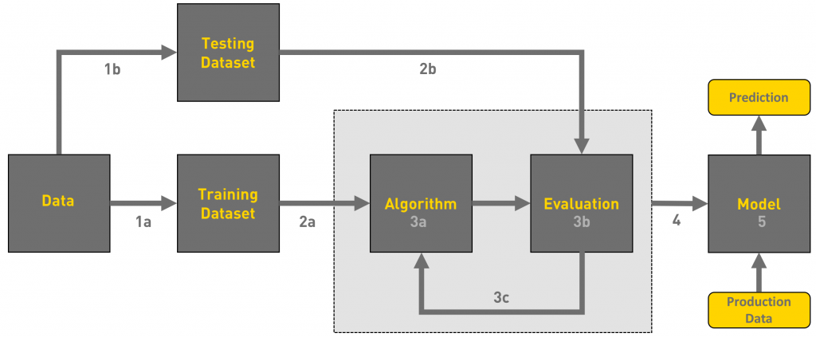
Work strategy
Data Science Intensive Capstone Project
Data Collection
Feature Engineering
Model Development and training
Model Evaluation
Model Performance Comparison
Future Work
Image credit: https://towardsdatascience.com/workflow-of-a-machine-learning-project-ec1dba419b94

Slide 10
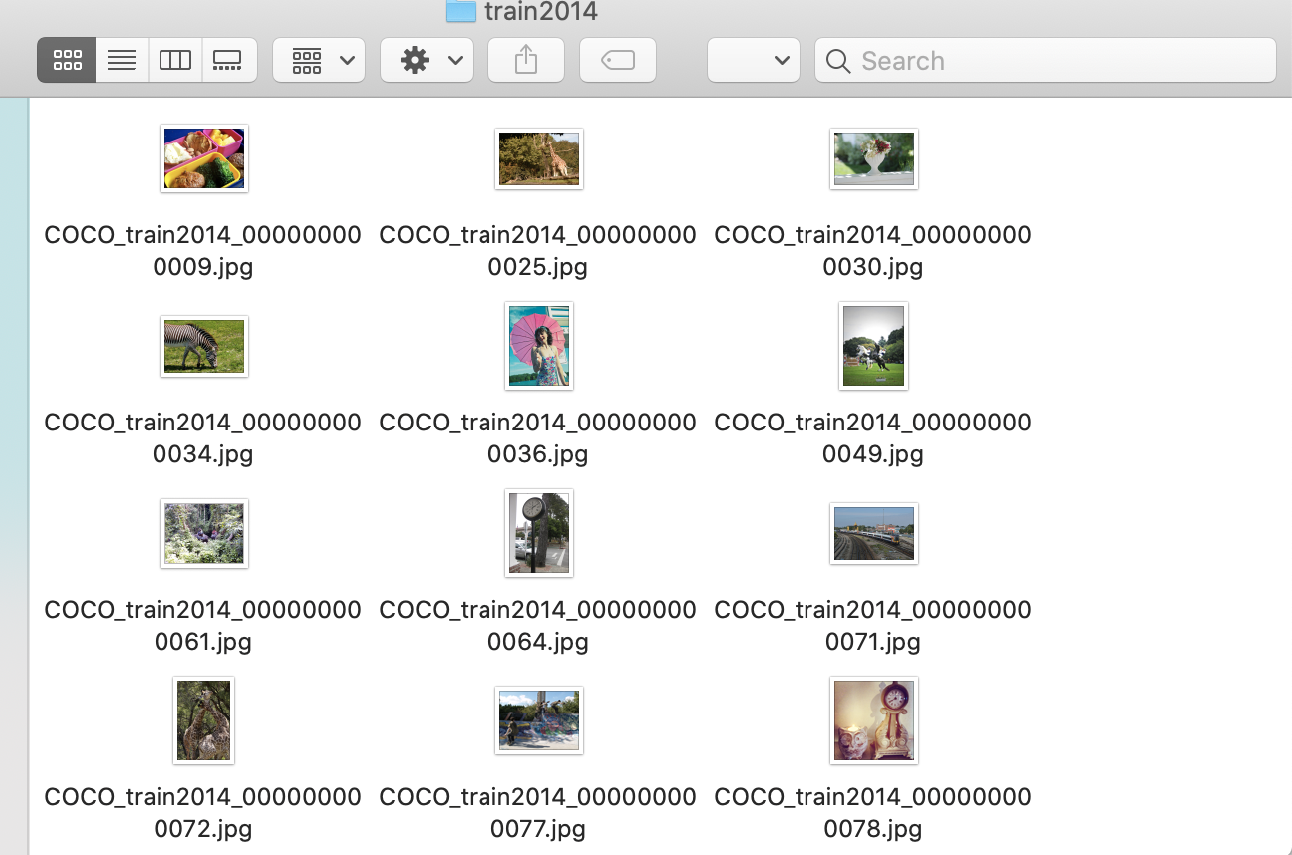
Data Collection
Data Science Intensive Capstone Project
There are few publicly available datasets available for image caption generation, e.g., Flickr30K, MS-COCO, Google conceptual caption dataset etc.
In this work, both the Flicker30K (30K images), and the MS-COCO (45K images) dataset is used.

Slide 11

Feature Engineering (Encoder)
Data Science Intensive Capstone Project
For image feature extraction, vgg16 and inception_v3 pre-trained model is used.
The final fully-connected layer is omitted from both the pre-trained model.
Before feeding the image features into the decoder model, they are encoded with a fully-connected layer with relu activation function.
VGG16 Model Architecture
Image credit: https://towardsdatascience.com/step-by-step-vgg16-implementation-in-keras-for-beginners-a833c686ae6c

Slide 12
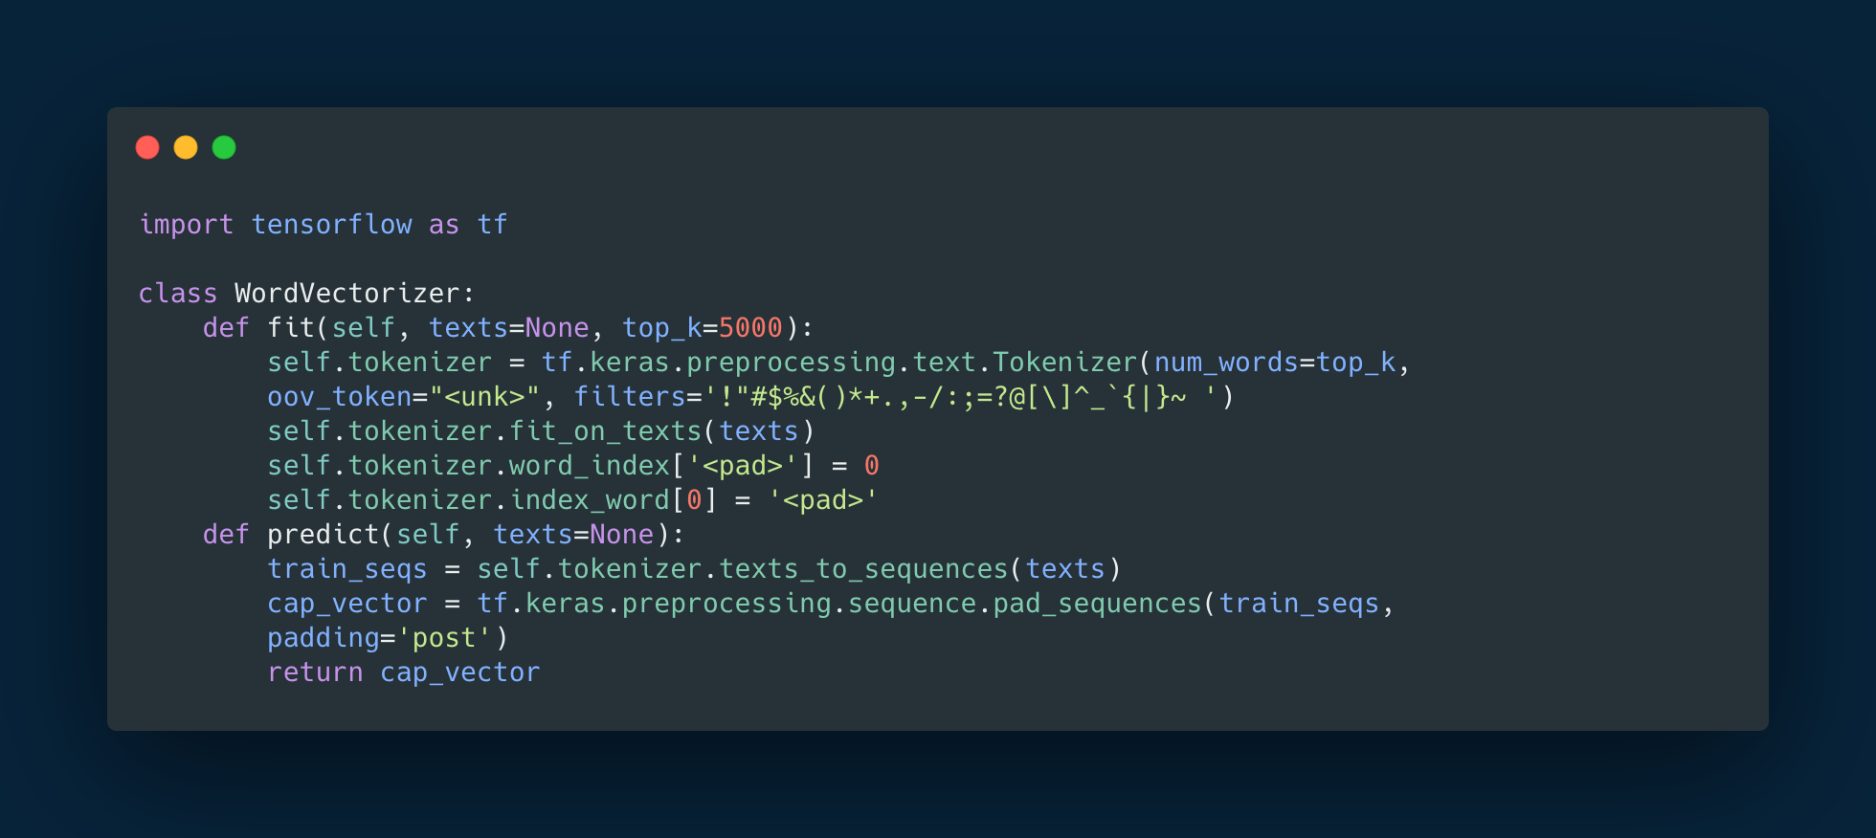
Feature Engineering (Encoder)
Data Science Intensive Capstone Project
For word embeddings, keras word tokenizer is used.
An embedding layer is used to vectorize the words for machine learning.
In future, pre-trained word embedding can be used to improve the model performance.

Slide 13
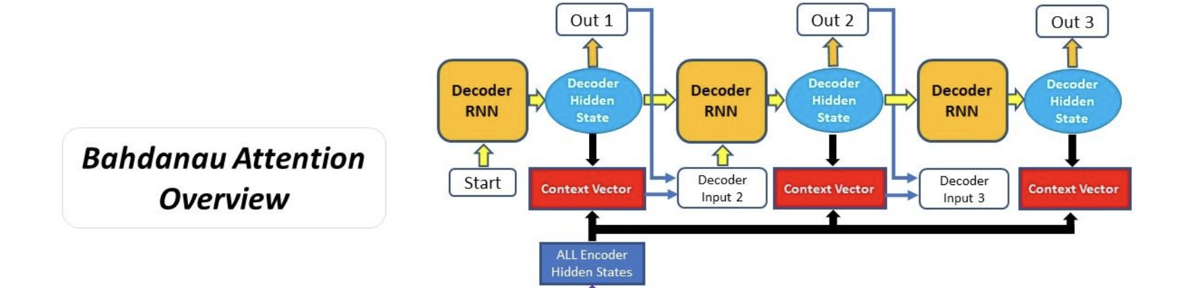
Bahdanau Attention Mechanism
Data Science Intensive Capstone Project
Encoder produces hidden states of the input image and sequence (in the beginning the sequence is ”<start>”)
Calculating alignment score of the previous hidden states and the new hidden states (query).
Softmaxing the alignment score.
Image credit: https://blog.floydhub.com/attention-mechanism/

Slide 14
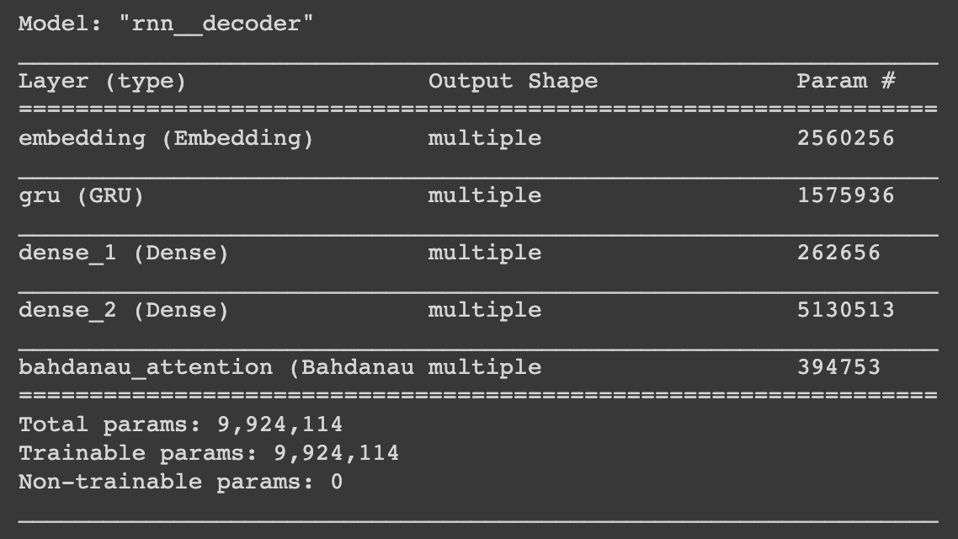
RNN Decoder
Data Science Intensive Capstone Project
Computing the context vector.
Decoding the output.
The process is repeated until “<end>” is reached or the max word limit is reached.

Slide 15
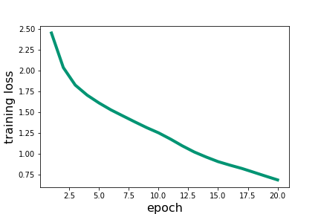
Flicker 30K dataset with VGG16 Encoder
Data Science Intensive Capstone Project
Trained for 20 epochs.
Training for more epoch may lead to improved performance.
BLEU score: 0.65 on the holdout validation set.

Slide 16

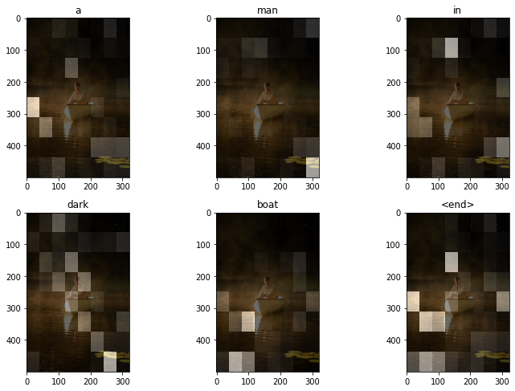
Flicker 30K dataset with VGG16 Encoder
Data Science Intensive Capstone Project
Real Caption: <start> a man in a white boat is rowing through fog <end>
Predicted Caption: <start> a man in dark boat <end>

Slide 17
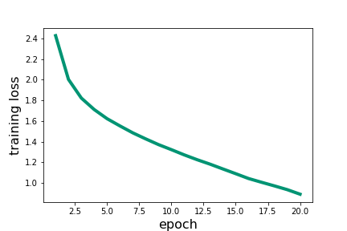
Flicker 30K dataset with InceptionV3 Encoder
Data Science Intensive Capstone Project
Trained for 20 epochs.
Training for more epoch may lead to improved performance.
BLEU score: 0.69 on the holdout validation set.

Slide 18
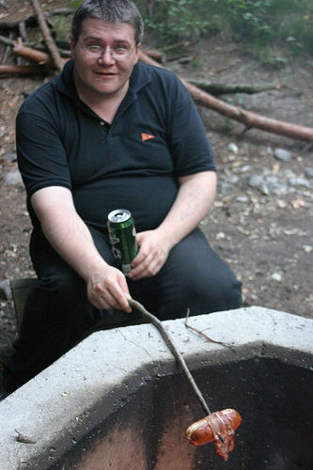
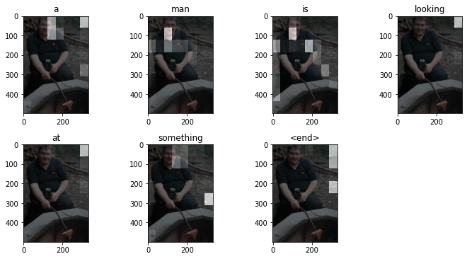
Flicker 30K dataset with InceptionV3 Encoder
Data Science Intensive Capstone Project
Real Caption: <start> a man having a beer and roasting a hotdog the old fashioned way on a stick over a fire pit <end>
Predicted Caption: <start> a man is looking at something <end>

Slide 19
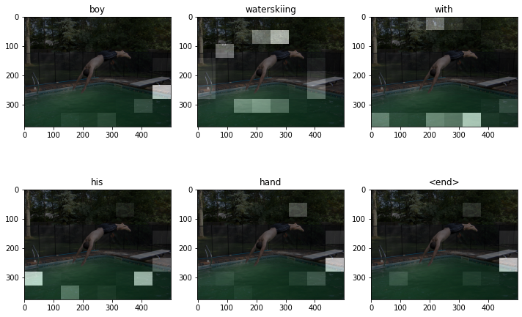
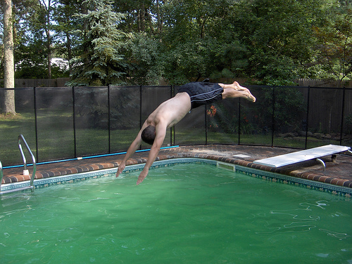
Flicker 30K dataset with InceptionV3 Encoder
Data Science Intensive Capstone Project
Real Caption: <start> man is diving off of a diving board into a built in pool <end>
Predicted Caption: <start> boy waterskiing with his hand <end>

Slide 20
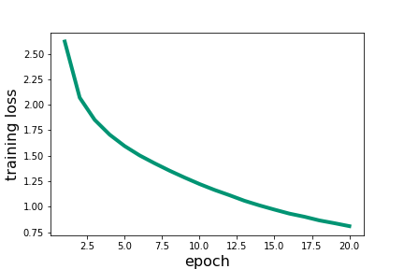
COCO dataset with VGG16 Encoder
Data Science Intensive Capstone Project
Trained for 20 epochs.
Training for more epoch may lead to improved performance but it’s close to hitting the learning curve plateau.
BLEU score: 0.71 on the holdout validation set.

Slide 21
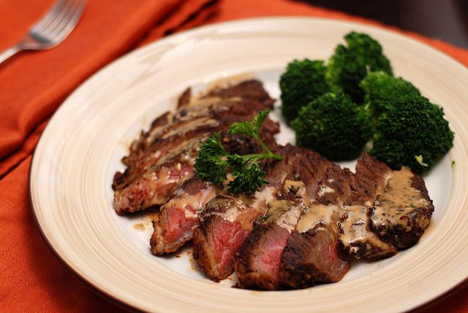
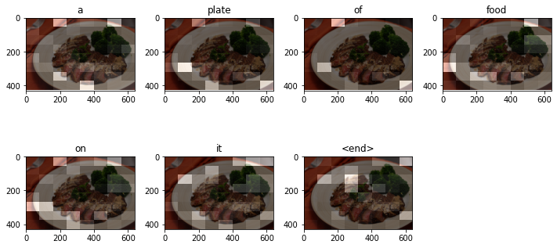
COCO dataset with VGG16 Encoder
Data Science Intensive Capstone Project
Real Caption: <start> a plate contains beef with a side of broccoli <end>
Predicted Caption: <start> a plate of food on it <end>

Slide 22
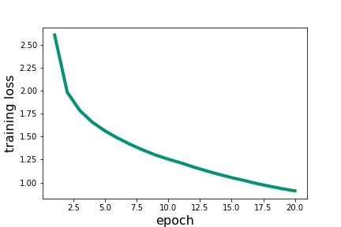
COCO dataset with InceptionV3 Encoder
Data Science Intensive Capstone Project
Trained for 20 epochs.
Training for more epoch may lead to improved performance but it’s close to hitting the learning curve plateau.
BLEU score: 0.73 on the holdout validation set.

Slide 23
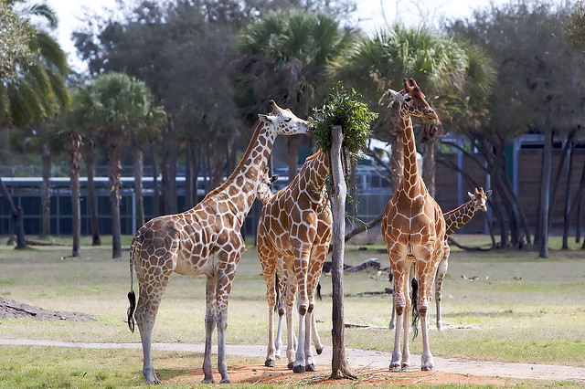
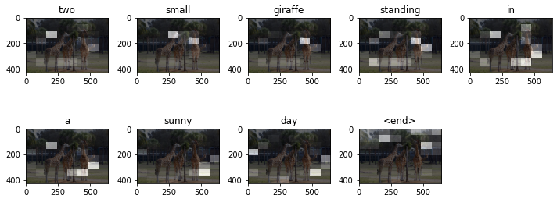
COCO dataset with InceptionV3 Encoder
Data Science Intensive Capstone Project
Real Caption: <start> the group of giraffes are eating what was left for them on the tree <end>
Predicted Caption: <start> two small giraffe standing in a sunny day <end>

Slide 24
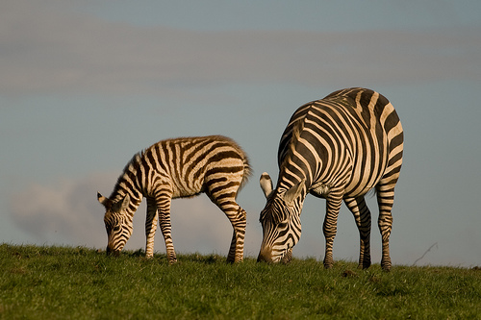
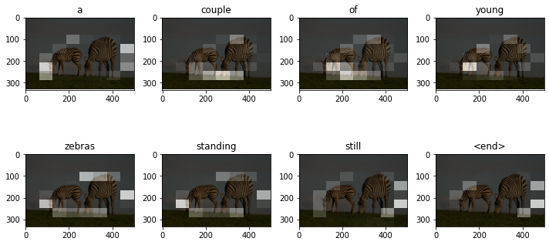
COCO dataset with InceptionV3 Encoder
Data Science Intensive Capstone Project
Real Caption: <start> two zebras standing together eating some grass <end>
Predicted Caption: <start> a couple of young zebras standing still <end>

Slide 25
Future Work
Data Science Intensive Capstone Project
Using different pre-trained image model.
Using pre-trained language model for word embedding.
Use a larger dataset.
Build a web-app for customer to interact with the final model.

Slide 26
Thank you!
Scientific Software Developer Interview Presentation
Osman Mamun, PhD
Email: mamun.che06@gmail.com
LinkedIn: https://www.linkedin.com/in/osman-mamun/
GitHub: https://github.com/mamunm

